Slide 1
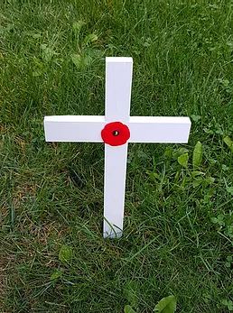
MDA SERVICE CONTEST SUBMISSION
March 2021
Lion Contact:
Betty Mills – bmills@lionsa16.com
Veterans
Decoration Day
In Haliburton

Slide 2
This unique service project is one
which any Lions Club can do in their community.
It would probably be better suited to smaller communities and the Haliburton Lions
are willing to share information and offer support.
This is also a project that once started can expand and can continue with adaptations depending on circumstances.
In this instance, Covid-19 threatened the project’s continuance but, with modifications, it carried on successfully. Thus, we have included photos from both years.
Planning will require working with:
Cemetery Offices
Municipality
Local Royal Canadian Legion
Local Schools
Local Service Clubs
Success will be enhanced by:
Contacting local media
Partnering with other organizations
Involving youth

Slide 3
Service Project Goals
To recognize Haliburton Veterans
To establish an annual Decoration Day exclusively for veterans buried in Haliburton graveyards
To involve future generations in this ongoing project
To create partnerships for ongoing funding and support
To expand this annual Decoration Day to a wider audience

Slide 4
2019 - The Groundwork Is Begun
In 2019,partnerships were formed with:
Royal Canadian Legion Branch 129
Haliburton Legion’s Ladies Auxiliary
Haliburton and District Lions Club
Three partners contribute $1000 as a start up fund.
Research identifies over 150 veterans buried in the cemeteries
Research begins on the history of the veterans’ service
Every grave in the cemeteries is photographed
It is discovered that at least 12 veterans have no headstone
at their grave site.
The Municipality of Dysart et al grants an Order in Council
to establish an annual Veterans Decoration Day on the third Monday
in September. Monday supports student participation.
The Independent Studies Class at the High School agrees to participate by
researching individual veterans and helping to lay crosses.

Slide 5
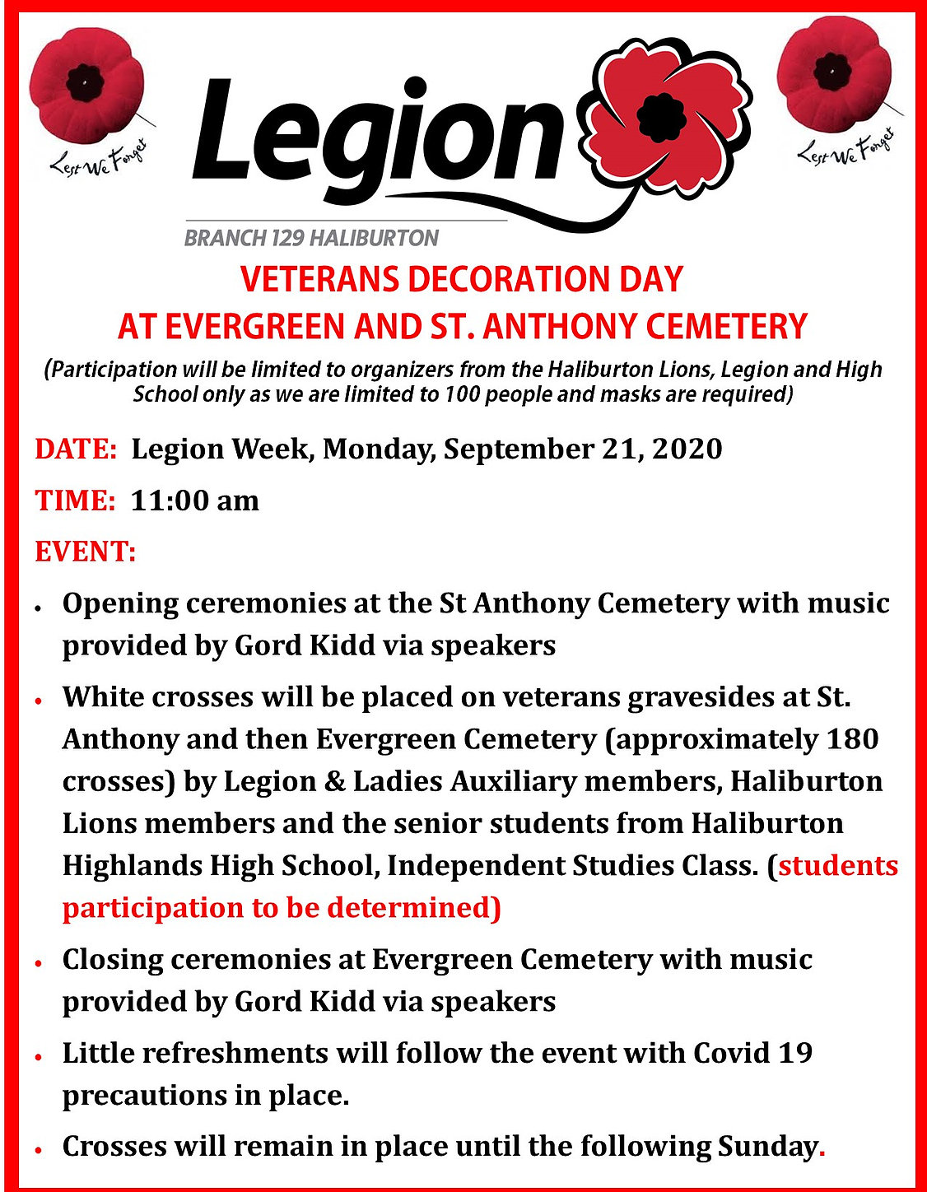

Slide 6
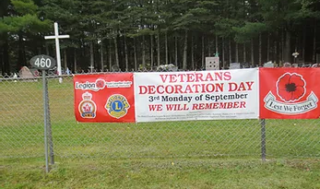
A banner is placed at each of the St. Anthony’s and Evergreen cemeteries.
The banners are placed a week before the event and remain up for a week after.

Slide 7
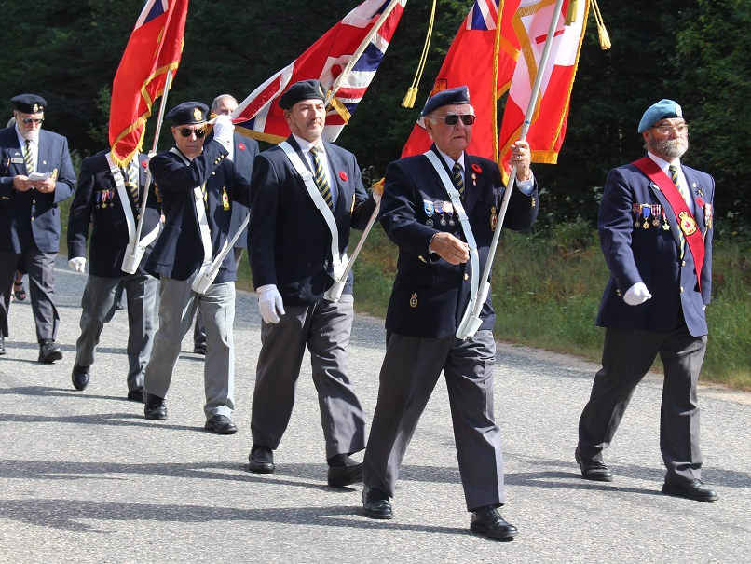
First year 2019

Slide 8
2019……..Haliburton Lions in attendance

Slide 10
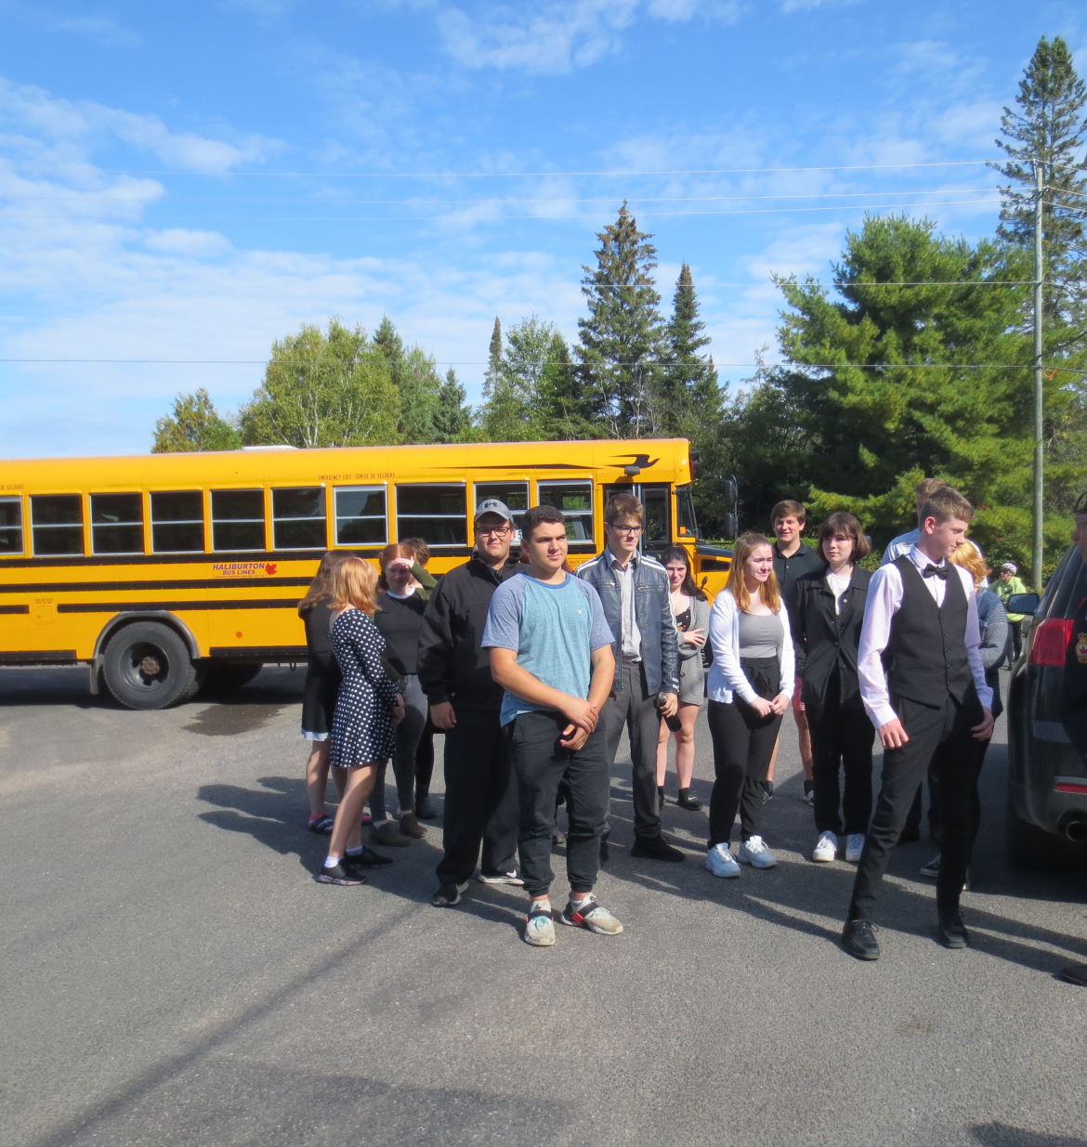
High School Students preparing to travel to cemetery in 2019

Slide 11
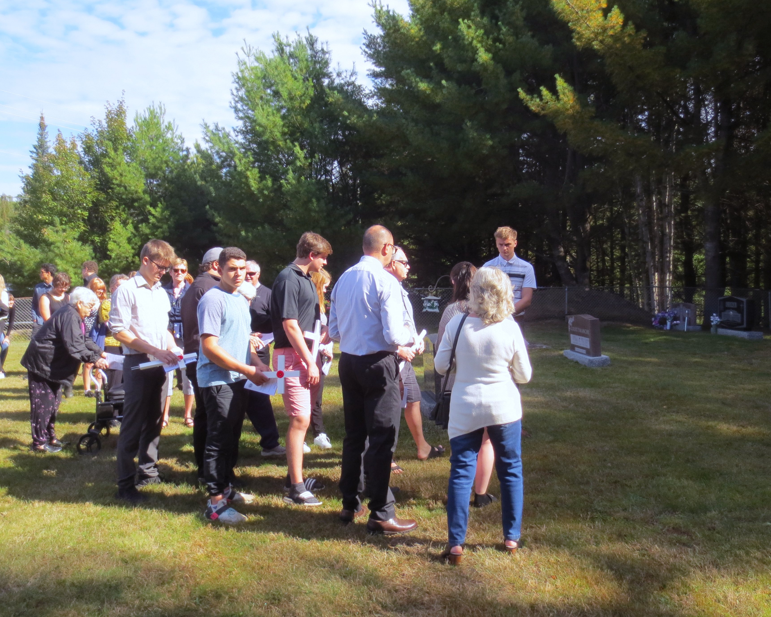
Students from the Independent Studies Class laying crosses

Slide 12
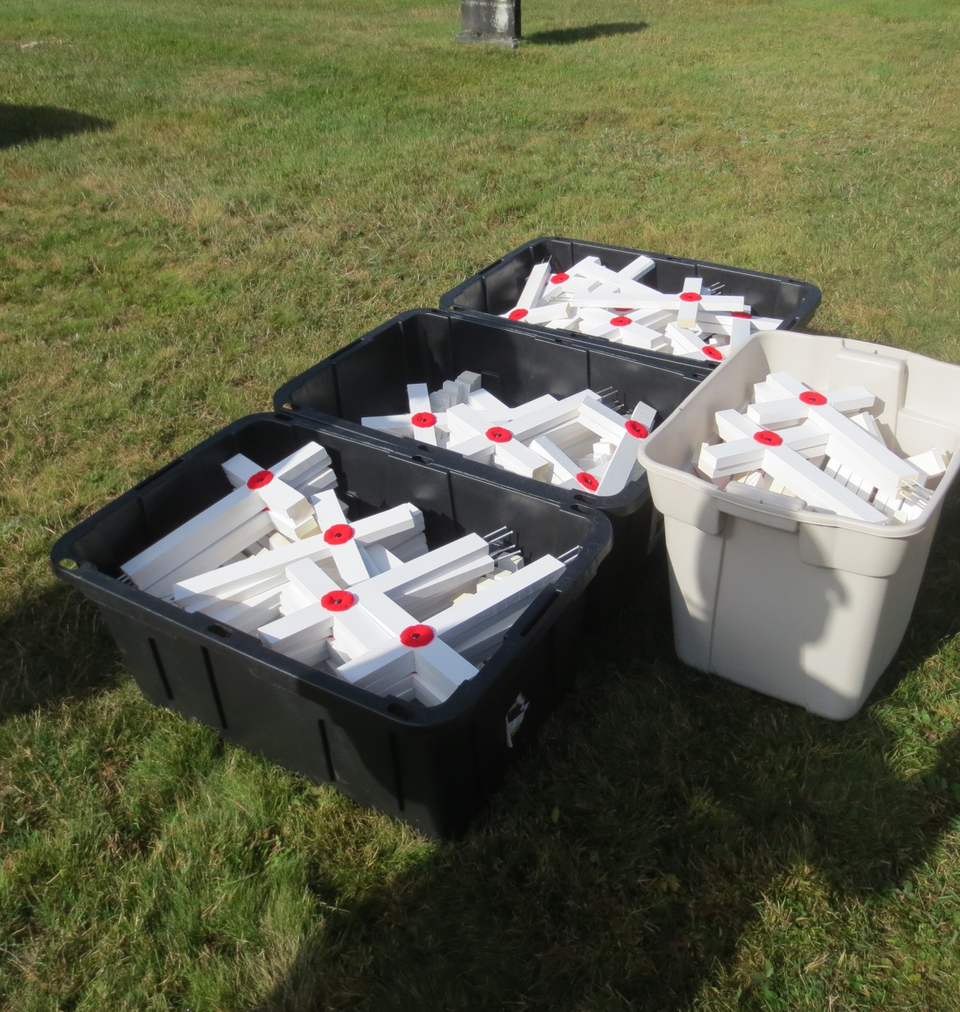
180 Crosses for the 180 graves researched and identified
The crosses were handcrafted
by Legion Members.

Slide 13
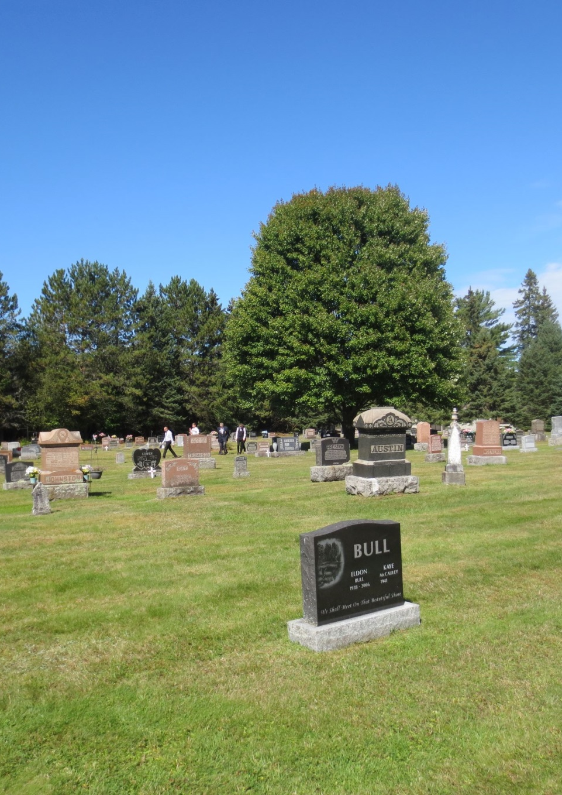
Grids were created to help search for and identify the grave sites

Slide 14
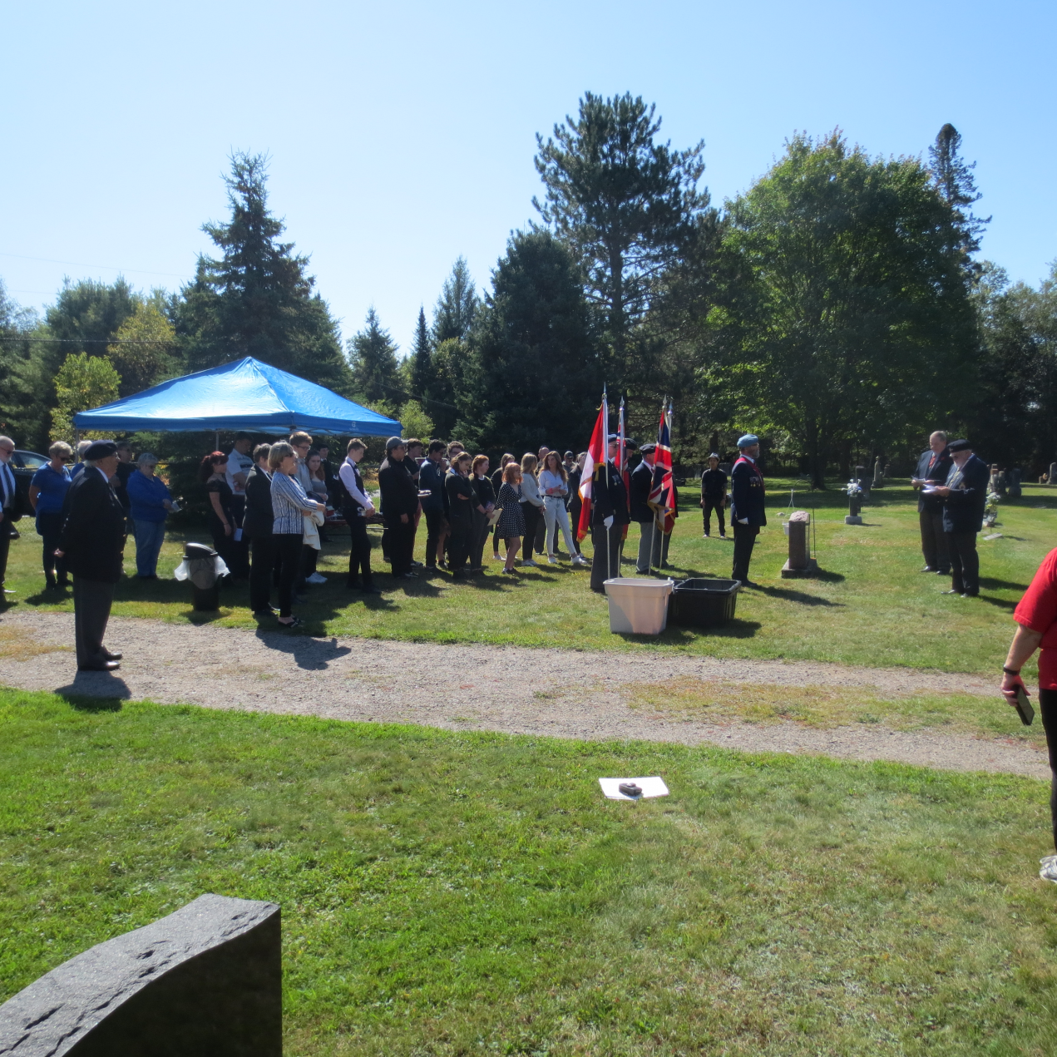
The service in progress

Slide 15
Modified Decoration Day in Haliburton
In 2020 due to Covid restrictions: Students and pipes & drums were unable to participate.
Community participation is limited
Haliburton Lions provided music, refreshments and additional manpower. It was important to keep this project alive and meaningful.

Slide 16
Colour Party preparing to assemble and march in 2020.

Slide 17
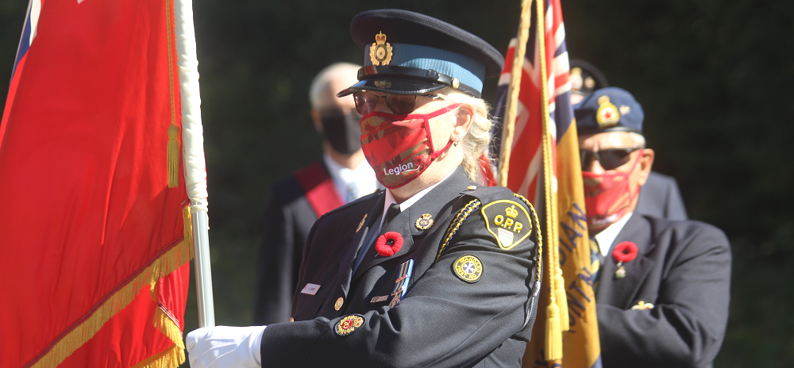
Colour Party 2020

Slide 18
Local Newspaper Coverage

Slide 19
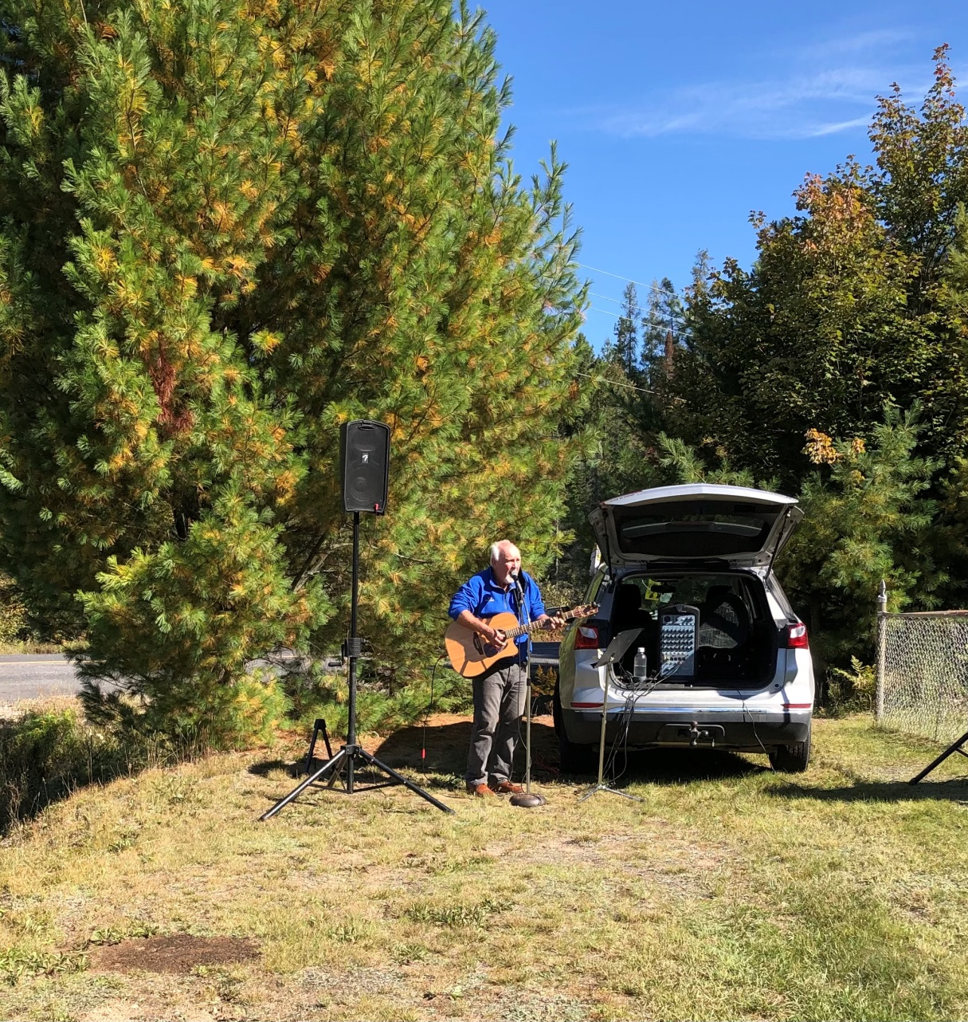
Lion Gord Kidd provided music 2020

Slide 20
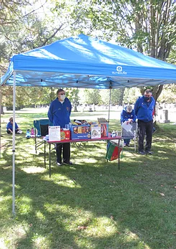
Haliburton Lions refreshment tent 2020.
All refreshments were served following safety protocols.

Slide 21
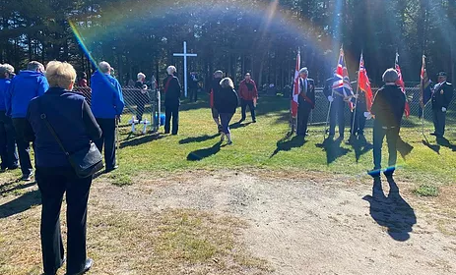
St. Anthony’s - a rainbow to honour our vets

Slide 22
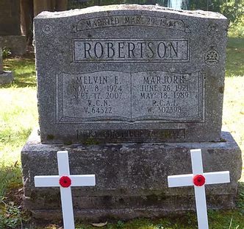
Two of our vets honoured with crosses

Slide 23
Going Forward
Our goal is to have every grave marked with a headstone.
Research will identify such graves.
Permission to erect a headstone will be obtained.
Government Grants from Veterans Affairs are available
to have this work done.
Partners will continue to offer ongoing financial support
and manpower.
We will continue to include students as a bridge between
proud past and hopeful future.

Slide 24
At the going down of the sun
And in the morning
We will remember them.

